Slide 1
Shire HAE follow-up analysis project & MS project
Project methodology introduction
Zhao Jie
Jan 3th 2017

Slide 2
Content
Shire HAE follow-up
Objective
Dataset
Feature
Model
Evaluation / Test
Additional investigations

Slide 3
Shire HAE follow-up - Objective
To develop an algorithm to identify potentially undiagnosed HAE patients and then link them to treating HCPs
HAE is a rare hereditary condition. Since it is rare, physicians rarely encounter patients with this condition

Slide 4
Shire HAE follow-up - dataset
Confirmed HAE / positive patients (~1K)
Training data
A ~200K subset of the negative patients
A ~3M subset of negative patients
Small test data
Non-HAE / negative patients (~123M)
Final large test data
..\..\Shire\follow-up\03_results\Apr05\Apr14\summary_Apr14.xlsx

Slide 5
Shire HAE follow-up - feature
Feature structure – demographic, diagnosis, procedure, rx
Show some data description:
..\..\Shire\follow-up\01_data\variable_for_presentation.xlsx
feature selection and transformation
Removing any ‘REGION’ information
Breaking AGE into 4 similar-sized levels (12 – 29, 30 – 49, 50 – 69 and >= 70)
Removing features using prior knowledge
Removing collinear features
Capping
Normalisation
Results:
..\..\Shire\follow-up\03_results\feature filter.xlsx

Slide 6
Shire HAE follow-up – Model (Bagging randomForest modelling)
Split HAE and non-HAE into 5 simulations
Bagging random forest in each simulation
Get performance on test data
Split HAE
Extract the corresponding non-HAE in each simulation using matching relationship
For the test data of each simulation,
Apply the N random forest models to the test data to get N predict scores for each patients
Aggregate(average) the predict scores from the N models for test patients
Aggregated the precision of 5 simulations by targeting recalls
get N random forest models
Combining each part of nonHAE with HAE dataset to fit the random forest
e.g. for N=10 the HAE:nonHAE in each part is 1:20(200/10)
For the training data, split the non-HAE into N parts
For each simulation, get the model performance on the test data. (recall precision pairs)
Get the averaged predict score for the test dataset.
Neg
part1
Model1
pos
part2
Model2
Part…
Model…
part10
Model10

Slide 7
Shire HAE follow-up - Evaluation / test
How to do the evaluation ?
First on a benchmark dataset ~3M
Metric used in performance
Ideally the evaluation / test shall be on a dataset that has a similar class imbalanceness as 1K:~123M
The metric to use is the precision at low-levels of recall,
e.g. the average precision of recall values at 0.03, 0.04, 0.05, 0.06 and 0.07
Finally on the large dataset ~123M
Get the prediction result by applying the final model on the final large dataset
get the targeting patients which falling into targeting recall bucket
Results:
..\..\Shire\follow-up\03_results\Apr05\Apr14\summary_Apr14.xlsx
..\..\Shire\follow-up\03_results\May04\summary results based on the three new datasets May04.xlsx

Slide 8
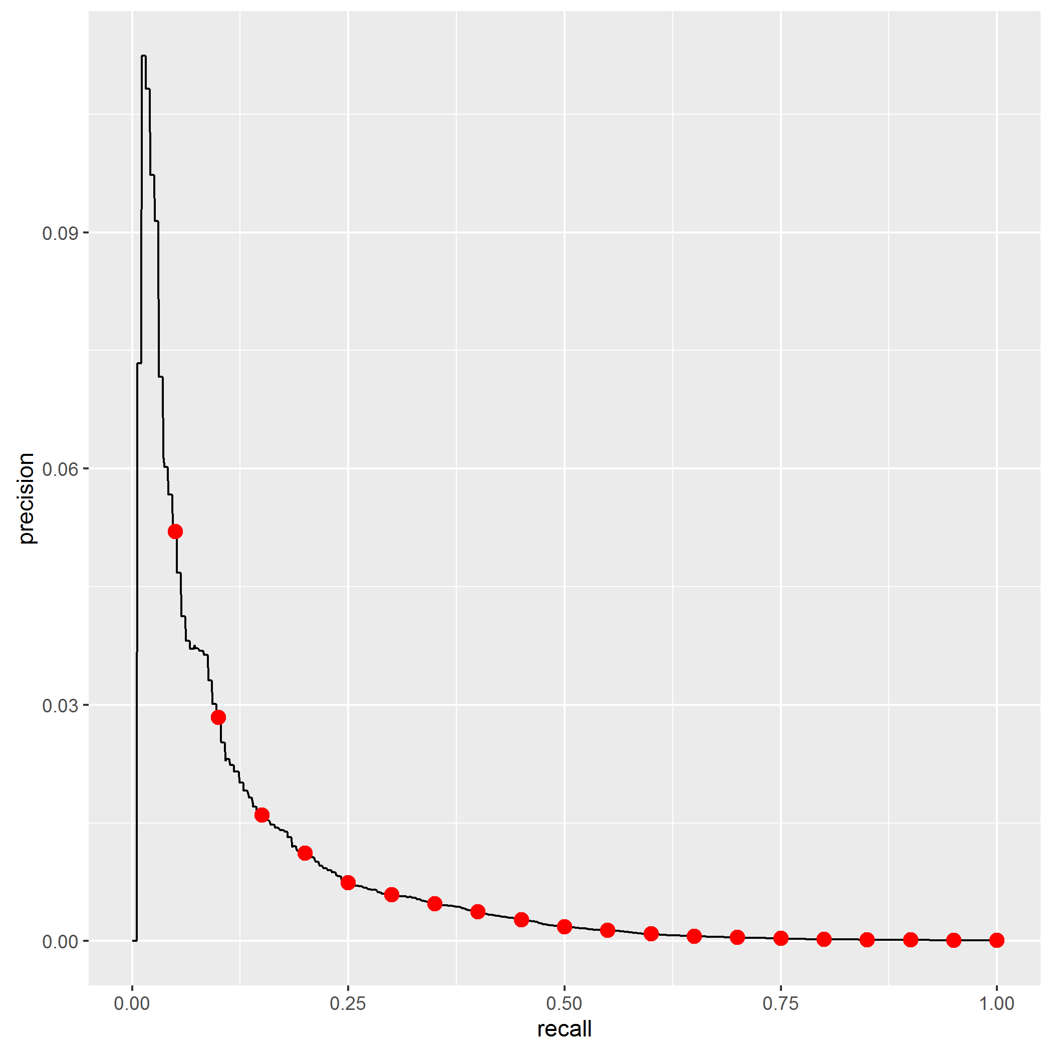
Shire HAE follow-up - Evaluation / test
What is the model performance?
~5.2% Precision at 5% Recall:
When the goal is to find 5% of all HAE patients, roughly every one patient in 20 patients in the modeling dataset is correctly identified as HAE
Of all patients who were flagged as HAE, what % actually have HAE?
This compared to a “prevalence” of just 0.5% for the modelling dataset as a whole
Precision
recallBkt | score_avg | cnt | TP
(0,0.05] | 0.913017 | 6629 | 50
(0.05,0.1] | 0.871617 | 21622 | 100
(0.1,0.15] | 0.832049 | 50184 | 150
(0.15,0.2] | 0.793032 | 87343 | 200
(0.2,0.25] | 0.748331 | 173429 | 250
(0.25,0.3] | 0.705189 | 175521 | 300
Recall
What % of actual HAE patients were flagged as HAE by the model?

Slide 9
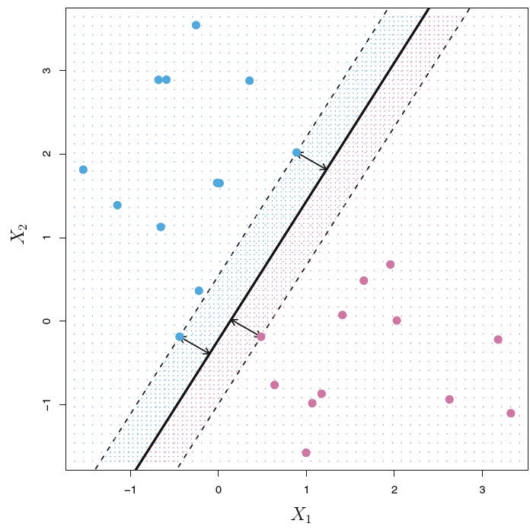
Shire HAE follow-up – additional investigation (similarity model)
selection of negative patients similar to the positive class
..\..\Shire\follow-up\03_results\Mar28\perf_Similarity_Mar28.xlsx
First-stage lasso model
To get the prediction on the test data
Second-stage lasso model
Using the new formed data
Give a select rate of how many patients do you want to select from negative ones
Get a threshold of prediction for the negative patients selection
Select the negative ones using the threshold
To get the prediction for the new test data
Get the model performance
Based on the true label, first-stage flag and the prediction in the second-stage

Slide 10
Shire HAE follow-up - additional investigation (easy positive selection )
weighting the ‘easy’ positive patients
why
Pay attention to precision on targeting recall
No need to recall all the positive ones
how
Do selection/weighting before model training
e.g. KNN/similarity model
Split evaluation and validation folds,
object
Pay attention
For finding “easy” positive ones
stratify samples according to the positive weights proportion
measuring the local neighbourhood purity of every positive patient

Slide 11
Shire HAE follow-up - additional investigation
positive
negative
First-stage lasso/KNN
First-stage lasso
Add weight
Prediction on negative
Give a threshold to select negative
Weighted positive
Selected negative
Split evaluation folds
Model
Split validation folds for CV
......

Slide 12
Shire HAE follow-up - additional investigation (ensemble model)
ensemble modelling for classification
Build week learner pool
Candidate models
e.g. logistic regression, lasso, RF, SVM
Get performance on validation for all weak learners
Cross validation for all weak learners
Get top winners
Several top winners
Get aggregate prediction on test data
Parameter combination for grid search
Apply the best parameters on validation data for all weak learners
e.g. weak leaners with top 5 precision values on targeting recall
Only use the top winners
Train models on train + validation
Apply the models on the test data
Get aggregated prediction values across all winners

Slide 13
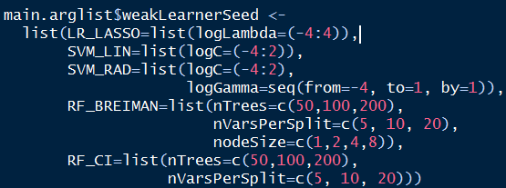
Shire HAE follow-up - additional investigation (ensemble model)
ensemble modelling for classification
Build week learner pool
Candidate models
e.g. logistic regression, lasso, RF, SVM
Get performance on validation for all weak learners
Cross validation for all weak learners
Get top winners
Several top winners
Get aggregate prediction on test data
Parameter combination for grid search
Apply the best parameters on validation data for all weak learners
e.g. weak leaners with top 5 precision values on targeting recall
Only use the top winners
Train models on train + validation
Apply the models on the test data
Get aggregated prediction values across all winners

Slide 14
Shire HAE follow-up – additional Investigation
Information loss from reducing the number of variables from 240+ to 80+
Result:
..\..\Shire\follow-up\03_results\Apr05\Apr21\covariates_retained_lasso_Apr21.xlsx
.\..\Shire\follow-up\03_results\Apr05\Apr19\performance_summary.xlsx

Slide 15
Content
MS
Objectives
Study design
Analysis workflow
Create cohort data
Create descriptive stats table
Create cohort data for modelling
Modelling
Information we focus on for the above three type models
Cross-validation resampling
Variable exploration

Slide 16
MS - Objectives
Primary objective
To estimate the overall probability of relapse over a twelve-month period
secondary objective
To produce predictions of disease activity and progression over a twelve-month period as defined by a number of outcome measures
exploratory objective
To produce predictions using advanced machine learning methods to compare these with baseline estimates using penalized multiple logistic regressions

Slide 17
MS – Study design
Data will be extracted for RRMS patients receiving BRACE therapy and will be divided into five cohorts:
Patients continuing on BRACE therapy
Patients switching to alternative BRACE therapy
Patients switching to first-line oral therapy
Patients switching/escalating to second-line therapy
Composite cohort combining the above cohorts
The index date is defined as the date of
Switch/escalation
The most recent visit that will allow for 12 months of post-index data (in the BRACE continuation cohort)
The analysis will model six alternative, binary outcome measures:
Relapse
Expanded Disability Scale (EDSS) progression
Confirmed EDSS progression
Relapse or EDSS progression
Relapse or confirmed EDSS progression
Relapse and EDSS progression

Slide 18
MS – create cohort data
Cut the continuous variables into buckets
e.g. age → age__le30, age__31to40, age__41to50, age__ge51,
For categorical variables
For those variables whose levels have ordinal relationship, merge small levels in categorical variables into 1 level with order
(e.g. edss_score→ baseline_edss_score__0_1, baseline_edss_score__1d5_2, baseline_edss_score__ge2d5)
For those variables whose levels have no ordinal relationship, merge small levels in categorical variables into 1 level without order
(e.g. birth_region → birth_region__Central_Europe, birth_region__missing, birth_region__others)
Convert categorical and numeric variables to dummy variables
Some adjustment according to client’s requirement for the variables included in modeling

Slide 19
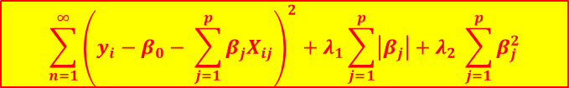
MS – Modelling
$${\sum_{n=1}^{∞}{\left(y_{i}−β_{0}− \sum_{j=1}^{p}{β_{j}X_{ij}}\right)}}^{2}+λ_{1}\sum_{j=1}^{p}{\left|β_{j}\right|+λ_{2} \sum_{j=1}^{p}{β_{j}^{2}}}$$
Elastic net is to try to find β to minimize the quantity:
Elastic-net with all the base variables
Elastic-net with the top 10 important variables
Standard logistic regression with the top 10 important variables
Simple explanation about elastic-net
ROC curve
Coefficient of all the alpha in each evaluation folder
How to get the importance score of variables
Get the covariate rank according to the absolute coefficient in each alpha of each folder
Average all the rank in all alphas of all folders
ROC curve
Coefficient estimate and CI

Slide 20
MS – Information we focus on for the above three type models
Model performance
Variable importance
Odds ratio for standard (unconstrained) logistic regression
AUC
Corresponding confidence interval
Number of Times Variable Retained
Average Coefficient
Average Odds Ratio
Odds ratio
Corresponding confidence interval
P-value
Based on most important ten variables
Actual outcomes by quintile of predicted risk score
based on logistic regression with elastic-net for most important ten variables
5 quintile Groups
Results:..\..\MS\result\Aug17\2016-08-16 04.23.25\1\BConti\Tables

Slide 21
MS – Cross-validation resampling
Model dataset
Stratify sampling
80% used as
training data
20% used as testing
data
1/5 | 1/5 | 1/5 | 1/5 | 1/5
5-fold cross-validation (CV):
1/5 of the training data was used as validation data to test the model performance
4/5 of the training data was used as sub-training data, hence altogether yielding 5 sub-training datasets
Code:
..\..\MS\04_Delivery\03_InitModel_NonRegulatizedGLM\02 Code\InitModel\functions

Slide 22
MS – Variable exploration
Use random forest/SVM
Divide new groups of variables for exploration
Cohort + outcome
e.g. visit reason is one group, Cerebrospinal fluid is another, etc.
– show how group variables look like
Focus on the composite cohort + 3 types of outcomes, namely relapse, edss progression and confirmed edss progression
Data size
stratify the data into 2 halves (different for every outcome)
Hide one half permanently (we’ll probably never touch it)
we use the other half to do the following experiments
Do the experiment
say there are K groups obtained, then we do 2 * K experiments for each of the cohort + outcome combinations
For each experiment, use all the base predictors + ONE group of new variables, produce the test and training AUCs (Remember that everything in this experiment only uses one half data produced!!)
For each specific new group, do two experiments: one using our existing elastic net and the other using the newly implemented random forest/SVM. This will give us two test AUCs for the same group, which tells us whether the new group is helping the prediction.
do this for all K groups. This tells us which groups are helping

Slide 23
MS – Variable exploration
Results:
..\..\MS\04_Delivery\32_RF\03 Results\2016-08-03 08.02.16\Cmp\outcomes_grp_auc_tr_ts.csv
..\..\MS\result\Aug03\outcomes_grp_auc_tr_ts_Aug03.xlsx

Slide 24
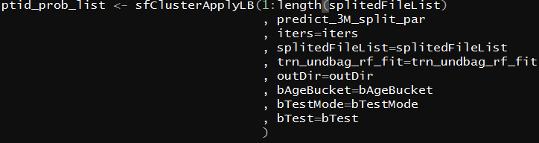
Some experience to share
when using easy positive weight, pay attention to make sure that the patient id and the observations you selected are consistent.
Avoid confusing coding
Bad coding
Good coding

Slide 25
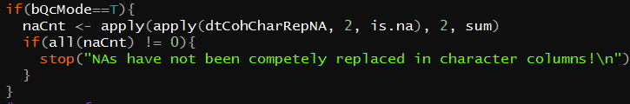
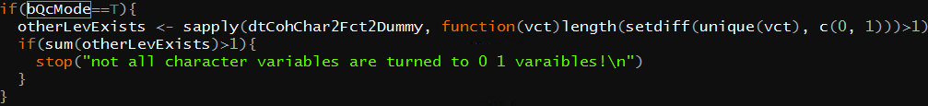
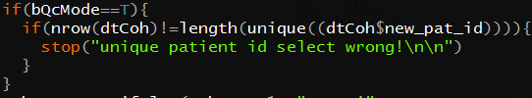
Some experience to share
Add some qc code to make sure that the result of each step is what you want

Slide 26

Some experience to share
Test the code using small dataset before running all dataset
Use regular expression to help to concise your code (available in R, python and SAS)
In condition of multiple cores and time-consuming of code running, make good use of parallelization to shorten the running time, sometimes need to use nested parallelization to further speed up the running

Slide 27
Some experience to share
Whole data set
~2G
Split into small parts
50 parts
part1
~10M
part2
~10M
Part…
~10M
part49
~10M
part50
~10M
If the memory usage is large due to the big dataset, split the data into small parts, then parallelize the whole process with all parts at the same time
An example of getting the prediction of a big dataset
core1
core2
Core…
core49
core50
Prediction of part1
Prediction of part2
Prediction of part…
Prediction of part49
Prediction of part50
Prediction of whole dataset

Slide 28

Some experience to share
To avoid changing the old result folder, use time stamp to name the folder of each run
Avoid using for loop, and use function as far as possible
Safety
speed
Make use of git to save every step of your coding, so that you can trace back every modification of your code

